Slide 1


Slide 3




4
2
3
1
PROUCT YOUR EYES
DON’T GO OUT FROM 11 TO 3
SEEK SHADE
HYDRATE

Slide 4
4
3
1
2
PROUCT YOUR EYES
SEEK SHADE
HYDRATE
DON’T GO OUT FROM 11 TO 3

Slide 5
4
1
2
3
PROUCT YOUR EYES
HYDRATE
DON’T GO OUT FROM 11 TO 3
SEEK SHADE

Slide 6
1
2
3
4
HYDRATE
DON’T GO OUT FROM 11 TO 3
SEEK SHADE
PROUCT YOUR EYES

Slide 7

DRINK TENDER COCONUT WATER

Slide 8
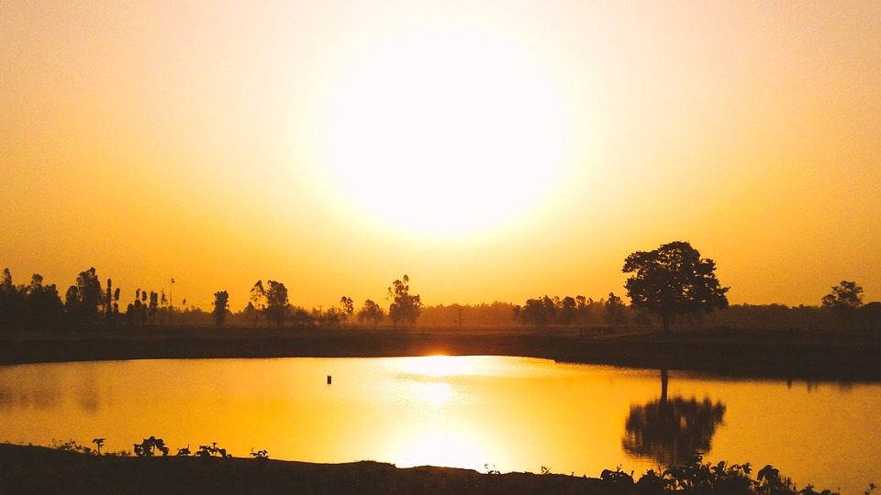
REFLECT
CAUTION

Slide 9

WEAR COTTON
CLOTHES

Slide 10

USE SUNSCREEN

Slide 11
THANK YOU AND ENJOY THE SUMMER!

